Slide 1
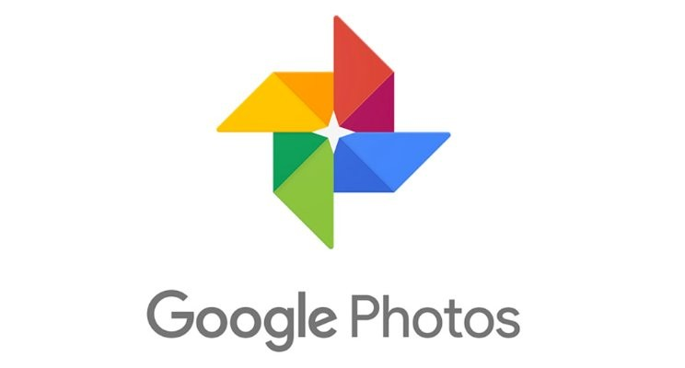
Google Photos Recommendation System
This presentation explores how Google Photos uses AI and ML to recommend photos and memories, enhancing the user experience.
by achyuth bandarupalli | AP22110010255
Notes:
1

Slide 2
Introduction to Recommendation Systems
Content-Based Filtering
Collaborative Filtering
Hybrid Methods
Recommends items similar to what a user likes.
Recommends items based on patterns among similar users.
Combines multiple approaches for better recommendations.
Notes:
2

Slide 3

Google Photos as a Case Study
Industry Leader
AI Integration
Relevance
Google Photos is a leader in photo storage, organization, and intelligent recommendations.
Analyzes photos with image recognition, sorts by categories like people, places, and events.
Google's use of AI in Photos has set industry standards for photo organization and retrieval.
Notes:
3

Slide 4

Google Photos Recommendation Techniques
Content-Based Filtering
Identifies visual attributes, such as color, objects, and people, in each photo.
Collaborative Filtering
Recommends popular memories and seasonal events, drawing on patterns seen across user interactions.
Notes:
4

Slide 5

How AI and ML Power Recommendations
Data Collection
1
Captures metadata (date, location), visual elements (faces, objects), and user interactions.
Image Processing
2
Uses machine learning models to detect faces, objects, and scenes, enhancing search and memory suggestions.
ML Algorithms Used
3
Deep learning, convolutional neural networks (CNNs), and natural language processing (NLP) for photo tags and captions.
Notes:
5

Slide 6
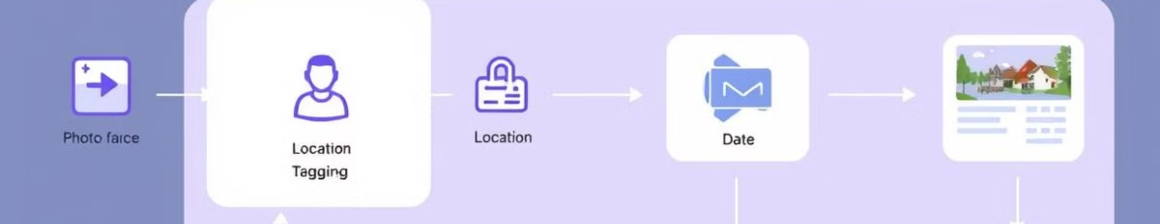



Implementation Techniques
Data Collection
Image Analysis
Similarity Analysis
Google Photos gathers metadata (date, location, device) and visual data (color, objects).
Uses AI models to detect features, categorize photos, and create visual groupings.
Applies similarity algorithms, such as cosine similarity, to find related images, enabling suggestions based on visual content.
Notes:
6

Slide 7
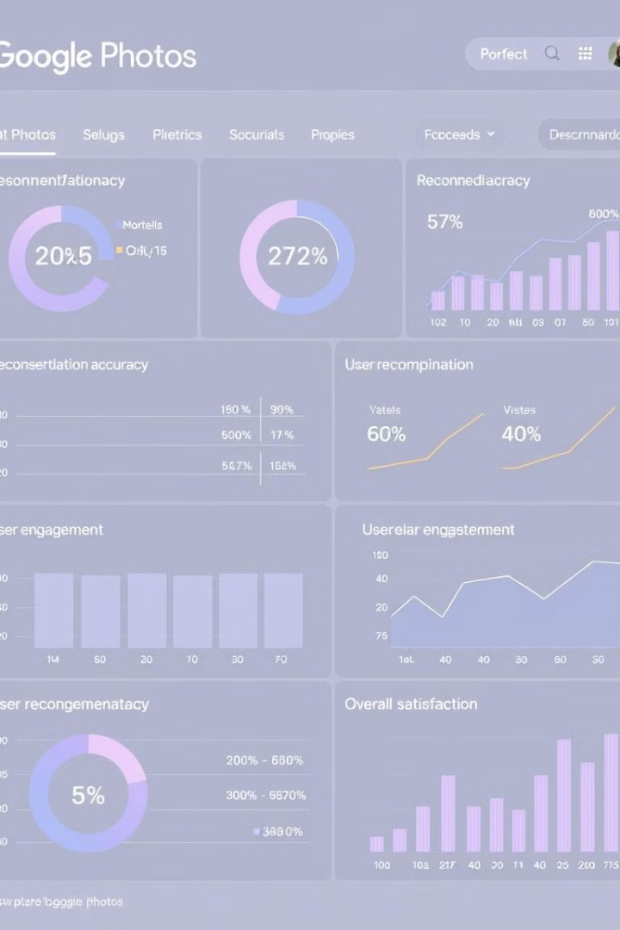
Metrics and Result Analysis
Precision
Measures the accuracy of recommendations (relevant photos suggested).
Recall
Evaluates how well Google Photos covers a user's interests.
User Engagement
Tracks likes, views, and shares on recommended photos.
Notes:
7

Slide 8
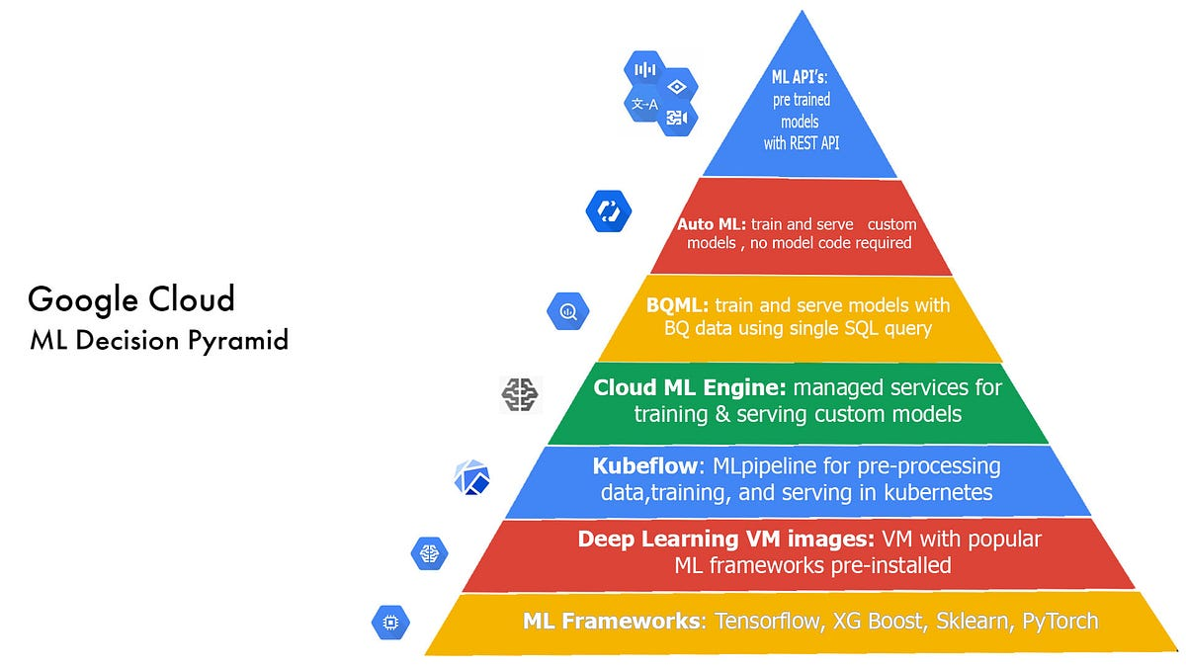
Error Metrics in Google Photos Recommendation System
Metric
Description
Mean Absolute Error (MAE)
Average error in recommendation predictions.
Precision at K
Relevance of top K recommended images.
Recall at K
Ability to find all relevant images within top K results.
F1 Score
Balances precision and recall for overall quality.
Mean Squared Error (MSE)
Measures squared difference between predicted and actual relevance.
User Engagement Metrics
Tracks views, shares, and other interactions to assess effectiveness.
Notes:
8

Slide 9
Conclusion
Summary:
Google Photos’ recommendation system uses advanced AI and ML to provide photo suggestions and memory reminders.
Future Scope:
Potential to improve personalization, incorporate user feedback, and explore interactive recommendations.
Final Thoughts:
Google Photos demonstrates how AI can turn a simple storage app into a meaningful, memory-rich experience.

Slide 10
THANK YOU

